Slide 1
API and Python training
Session 9
Notes:
Thanks for joining this session.

Slide 2
This session’s agenda
Open API specification (Swagger)
Connexion module
Re-writing API server using Connexion
Swagger UI console
Demo
Training summary
Notes:
Today our focus is documenting REST API.
When you build your API server, it’s important to provide your users and maybe even more important – future you, with good documentation.
Also understanding standards for API documentation will allow you not only to write, but also to read any API documentaion more efficiently.
We’ll use another Python module called Connexion, and I’ll show you how build a good-looking professional REST API documentation.
This is the last session in our training, so at the end of the session, I would like to summarize what we learned since October last year.
This session is going to be shorter than usual, so let’s get started.

Slide 3
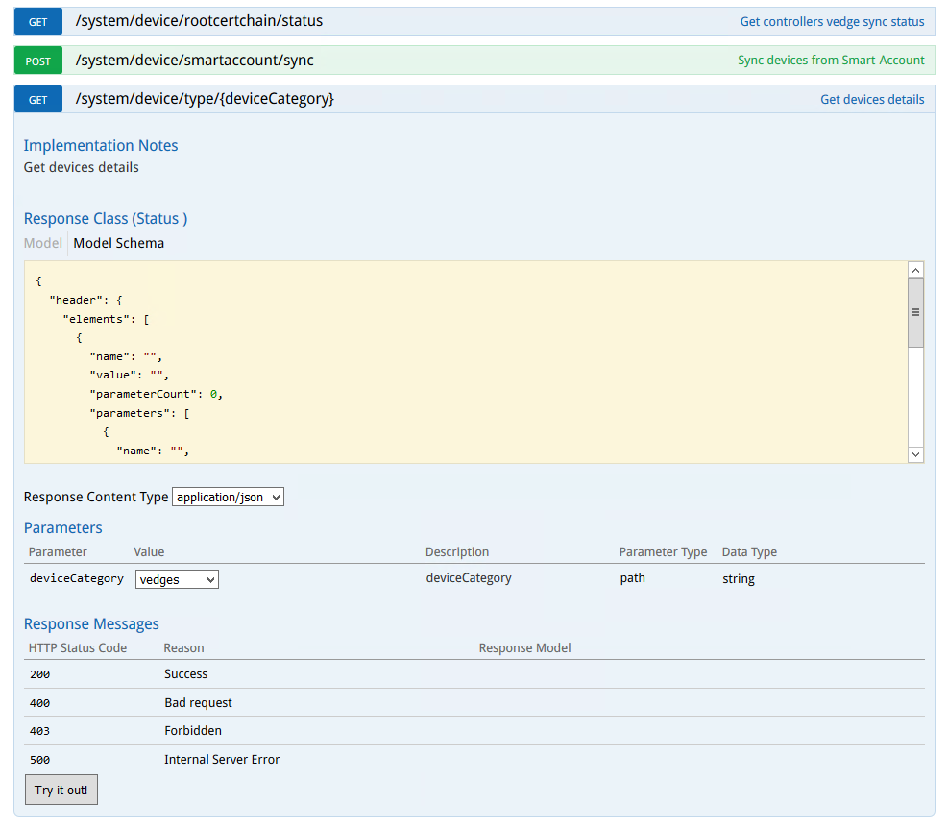
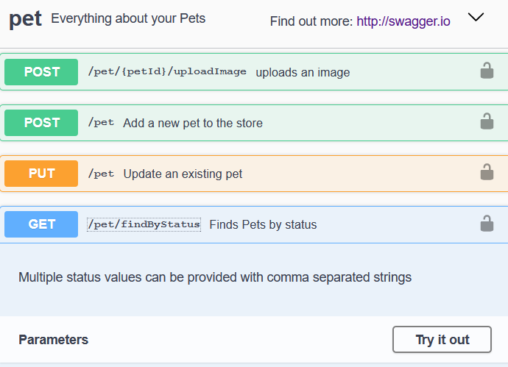
Open API specification (Swagger)
The OpenAPI Specification (OAS) defines a standard interface description for REST API
Describes API services and is represented in either YAML or JSON formats
Removes guesswork in calling a service
Human and machine readable
Two main versions – 2.0 (also known as Swagger) and newer 3.0 and 3.1
Can include interactive documentation (Swagger UI)
Check the doc:
Examples:
https://petstore.swagger.io/ Cisco vManage controller --->
https://github.com/OAI/OpenAPI-Specification/blob/master/versions/2.0.md
https://swagger.io/resources/articles/documenting-apis-with-swagger/
Notes:
Documenting of any technical solution is important, and REST API is not an exception, and actually I would say documenting REST API is critical, and I think it’s pretty clear why.
Even a single API endpoint normally consist of many elements, such as headers, parameters, response body formats, possible messages, and most of platforms providing REST API have hundreds of endpoints.
You can actually document your API in any way you want, but if you use a standard approach, it’s easier for users to understand it.
So when it comes to the REST API world, you may have heard of Swagger.
This is a de-facto standard of describing and documenting REST API interfaces.
It has been renamed to OpenAPI specification, but Swagger name is still widely used, so we’ll use Swagger and Open API Specification interchangeably.
There are two versions – 2 and 3, there some minor differences between them, but both versions are used.
Most APIs are documented using OpenAPi standards.
As a bonus, some libraries that document your API also offer Swagger UI console where your users can explore and test API directly, which is very-very handy.
On the slides you can see two examples, one from Swagger webside as a demo, and another is from Cisco vManage controller.
As you can see, there is endpoint description, and most importantly, description of request parameters, as well as response code and body content
Let me do a quick demo and show you an example of OpenAPI documentation and Swagger UI console, and this is what we’re going to build today.
Also have a look at the link provided, it describes various approaches to documenting REST API.

Slide 4
Demo
Notes:
Let me show you a quick example of REST API documentation, this is Sdwan controller Cisco vmanage

Slide 5
Connexion module
One of many tools which can help you documenting REST API
Connexion is a framework on top of Flask (but other servers can also be used)
Doesn’t generate specs based on the code, but you refer your existing Python functions in the spec
Write an OpenAPI specification in YAML file and map the endpoints to your Python functions
Validates requests and endpoint parameters automatically
Can handle basic and OAuth 2 token-based authentication
Provides Swagger UI console
install with pip:
pip install connexion
pip install connexion[swagger-ui]
https://connexion.readthedocs.io/en/latest/
https://github.com/zalando/connexion
Notes:
There are a few methods and tools you can use when it comes to documenting API.
Some tools intercept requests and responses and based on them build API documentation.
Other tools use static definition of API specs and you need to make sure your code works as described, so in this case API spesc work as a contract.
Connexion module is one of such tools where you describe your API in as much details as required and refer your Python functions in this definition file.
This module works on top of flask, can validate parameters, handle authentication and do some other useful things.
Also it provides Swagger UI console.
It’s free, community-developed, and as usual please have a look at the documentation.
I personally find it a bit confusing, so I would like to explain the key points in the next few slides.

Slide 6
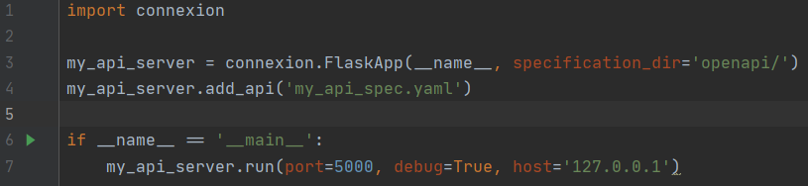
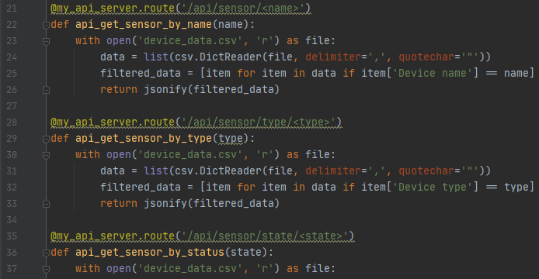
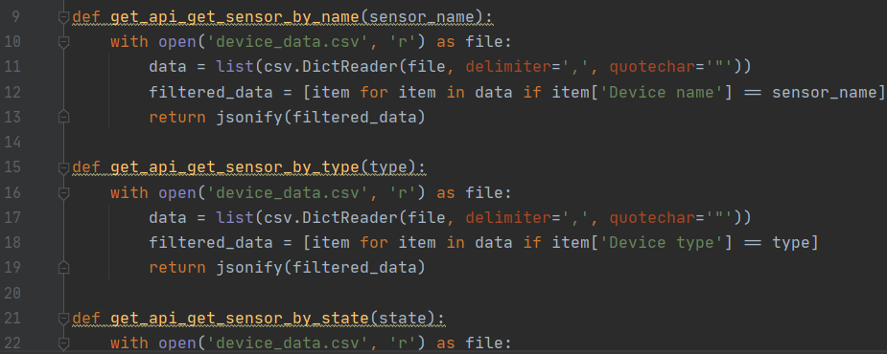
Re-writing API server
As it uses Flask, the syntax to run the server and its parameters is very similar (Line 7)
Define YAML specification file (Line 4)
You can put this file in a separate directory, add specification_dir parameter (Line 3)
In the file with Python functions handling API requests, you don’t need to define Flask routes anymore
Note lines 21, 28, 35 – defining routes: No Flask routes, only function definitions:
Notes:
If you remember last time we build a simple controller to return some data from our network of sensors, and today we’re going to re-write our code a bit to be used with Connexion.
As I mentioned, connexion uses flask, so the syntax to run the server is very similar to Flask, with some additional parameters - the file with your API specification, and optionally the directory where you store these files.
Also as we saw last time, we needed to define routes using flask decorators.
It’s not needed anymore, because API definitions including routes is now in a separate file, you’ll see it on the next slide.
Please have a look at two screenshots, you can see the original file with flask routes and the new file.
The new file looks simpler and cleaner, and we have clearly separated the code and routing which is good.
As a result, you’ll have 3 files – first you Python functions, second is the Python file where you run the server, and third – YAML file with API specification which we’re going to cover next.

Slide 7
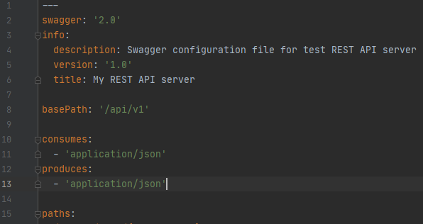
YAML Specification file – common settings
The file you defined as API specification file when started API server
Two main parts – common settings and paths
Common settings example:
Note basePath is added to all API endpoints,
<server><basePath><endpointPath>
----------->
Next, you define individual paths -------->
Notes:
The file you describe your API is a YAML file, and there two main sections
First, some global settings, as you can see, API description, version, server title, you can put there various useful details.
You also specify data format the server consumes and produces.
BasePath is the prefix which will prepend individual endpoint paths.
And in Line 15 you can see comes the section where we define our actual API endpoints.

Slide 8
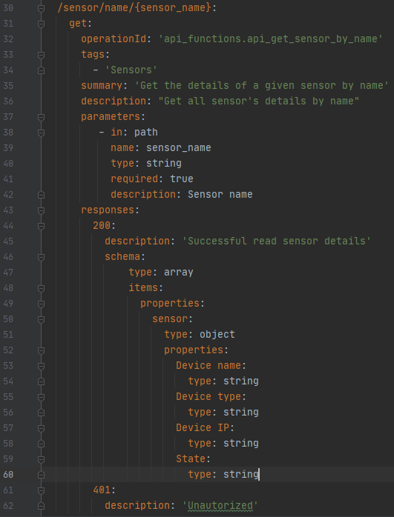
YAML Specification file - paths
Line 30 – path, variables are in {}
Line 31 – operation (GET, POST, etc)
Line 32 – operationID – refers to python function for the path
format: <file>.<function_name>
Line 33 – Tags allow grouping paths in Swagger Console (next slide)
Lines 37-42 - request parameters
Note name: (Line 39) - this should match Python function’s parameter
Lines 46-60 – describes response body content
types:
array = list
object = dictionary
int, string
Notes:
This is the main part of defining our REST API endpoint.
The format is pretty simple
First you define the path – Line 30, if the URL has variables, they are in curly brackets.
Then in Line 31 you define REST API operation, in your case it’s GET, and in Line 32 you link the endpoint to the Python function which handles the logic.
Note it’s file name dot function name.
You can use tags which will allow you to group and organise your API endpoints.
Have a look at Line 37 – parameters, here you specify which parameters are required, which are optional, type and description.
And finally, Line 43, you descried what response the client will receive if the operation is successful, or not.
In our case we say that if the client receives response code 200, it should also receive List (array) which consists of dictionary (object) with fields Device name, IP, etc.
This shows the example of the complete REST API documentation.

Slide 9
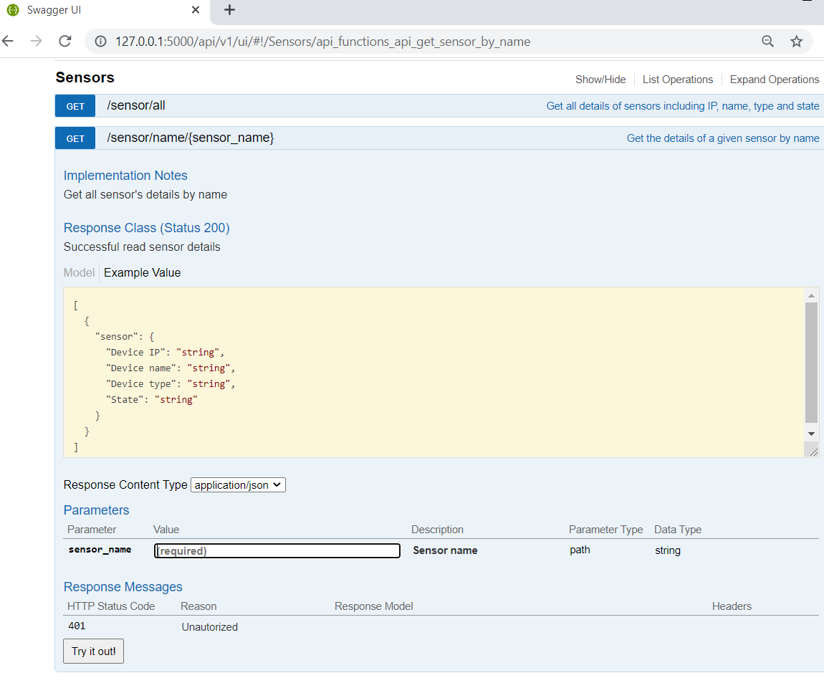
Swagger UI console
Allows you to validate your API doc
Allows users to navigate though API
Allows users to try API requests
In Connextion use path:
basePath+/ui
Where basePath is defined in YAML file
Notes:
Once you describe your API endpoints and routing in the YAML file, connexion renders it into Swagger UI console, and you can access it using slash ui.
Let you show you this in the demo.

Slide 10
Demo

Slide 11

Congratulations ! ☺
We’ve finished the Python and API training !
Notes:
And that concludes our training.
It’s been a long journey we started in October last year, and we covered a lot of content, and before we finish, I would like summarize the topics we covered.

Slide 12
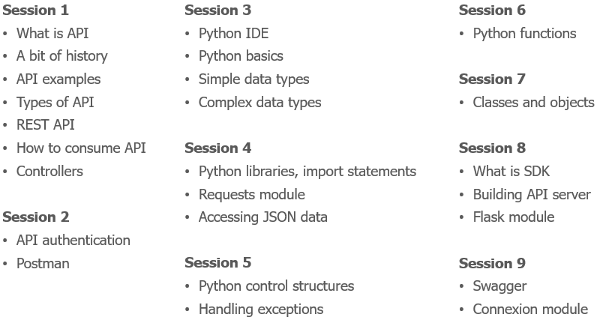
More than 9 hours of lessons
Notes:
We started with some bascis, why we use API at all, REST API concepts, definitions of headers, requests, responses and authentication.
We learned how to use CURL and Postman, made get and post requests to Cisco controllers and serviceNow and then switched to Python.
We again, started with basics, but as we progressed we learned more complex topics like handling exceptions, building your own classes and modules.
Our focus was consuming API with Python, but in last two sessions we also covered how to build API servers.

Slide 13
What we learned
What is API
A bit of history
API use cases and examples
Types of API
REST API
How to consume API
Webhooks
Controllers
REST API Authentication
Basic authentication
Bearer authentication
API Keys
OAuth
Cookies
Custom headers
Combination of methods
Practice – API authentication with cURL
Postman interface
Main features
Postman practice
Why Python
IDE - Integrated Development Environment
Python virtual environments
Variables
Simple data types – integer, float, string, bool
Data types conversion, output, f-strings
Complex data types – dictionaries and lists
Import packages
Python requests library
Making API requests
JSON
Control structures
If-else, if – elif -else
While
For
Using control structures for handling API responses
Handling exceptions
Recap from last session – nested data structures
Accessing JSON data
Python functions
Functions in programming languages
Functions in Python
Function arguments
Position vs named arguments
Variable scope
Return values
Classes
Class instances – Objects
Class properties/attributes
Class methods
OOP – Object-oriented programming
SDKs – Software Development Kits
Using SDKs in Python
SDK examples
Building simple API server
Recap from Session 1: Controllers
Northbound and Southbound APIs
Intro to Flask
Defining routes
Returning JSON data
Reading data from files
Filtering data - List comprehension
Open API specification Connexion module
Notes:
As you can see we learned a lot of topics, just have a look at this list.
Even though this training was made as an kind of introduction to REST API world, I think we learned REST API if not inside out, but very detailed.
REST API as a technology which is here to stay for years, and I reckon every engineer should know at least the basics.
I hope this training was useful and informative for someone who is new to Python, and I tried to build the slides in the way so you can return to them later and maybe use as a reference.
Obviously, this won’t replace 800-pages of Python book, but I hope the content of the 168 slides I built is worth reading.
In terms of next steps, Ideally, try to find a practical application of the skills you’ve got, think of any ideas, not necessary at work, but at home, maybe just try to automate something.
As an example, get a developer account in Service now, buy raspberry pi with temperature sensor, and integrate them with Slack.
This can be done with Python, I hope after this training you’re not afraid of doing so :)

Slide 14
Please provide your feedback
Was the training useful for you?
What you liked and (most importantly) what you didn’t?
What content would you add or remove?
Any specific topics you found boring and interesting?
Were there enough details and examples?
Would you prefer more practical exercises?
Would you prefer shorter session, or more often (2 times a week) ?
Would you be interested in further trainings, what topics?
Let’s connect in LinkedIn:
https://www.linkedin.com/in/alexander-zyuzin/
Notes:
I spent a lot of my personal time preparing the content for this training, and I would very much appreciate if you provide any feedback for this training.
I’ll post these question in Microsoft Teams, and you could reply there in Teams or send my an email.
Your feedback if very important, and I would like to thank these guys who asked question, who dropped me messages in Teams with positive and supporting words, it really helped me while I was working on the content.
I saw an Incident in our test ServiceNow instance with Incident name – thanks for the training, it was really nice, thanks for that.
I have some other ideas about future trainings, but if you have any suggestions, you’re very welcome.
As you may know, next week I’m leaving NTT, but I’m planning to have free public trainings on various topics in the future.
So let’s connect in LinkedIn, I’ll post any updates there.

Slide 15


Thank you for participating !
Stay curious and keep learning ☺
Notes:
I would like to thank you everyone who found the time to attend the sessions, and when I was saying at the beginning of each session - thanks for joining, that were really honest words, not just a formal into.
Finally, I would like to thank Sergey and Nikolay who reviewed and provided early feedback, that was also very helpful.
Thanks guys once again, I wish you all the best in your learning journey.

